Slide 1


Slide 2
Math 152
Lesson | Topic | Reading
17/18 | Applications to Physics & Eng | 8.3
19 | Modeling w/ Diff Eq/Dir Fields | 9.1/9.2
20/21 | Separable Equations | 9.3
Objectives:
Recognize what makes an equation a "differential equation"
Develop the general solution and find particular solution to a differential equation by applying initial condition(s)
Determine if a function is a solution to a differential equation
Calculate & describe equilibrium solutions for differential equations
Determine the nature of the solution using a slope field

Slide 3
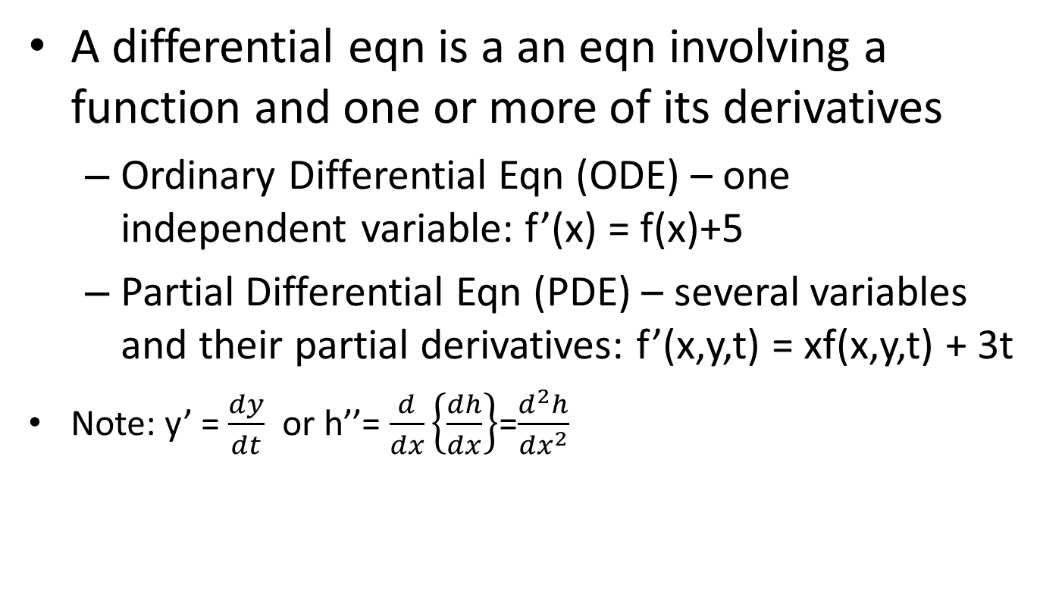
What are Differential Eqns?
A differential eqn is a an eqn involving a function and one or more of its derivatives
Ordinary Differential Eqn (ODE) – one independent variable: f’(x) = f(x)+5
Partial Differential Eqn (PDE) – several variables and their partial derivatives: f’(x,y,t) = xf(x,y,t) + 3t
Note: y’ = $\frac{dy}{dt}$ or h’’= $\frac{d}{dx}\left\{\frac{dh}{dx}\right\}$=$\frac{d^{2}h}{{dx}^{2}}$
We are only concerned with ODE’s right now

Slide 4
Equations of Motion (EoM)
Restoring
Force
Hook’s Law: F = kx
(neglect gravity)
How do I write the EoM (differential equations) for this system?

Slide 5
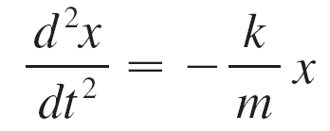
Equations of Motion (EoM)
Newton’s 2nd Law: F = ma
x = position
dx/dt = velocity
d/dt(dx/dt) = acceleration
Restoring
Force
Hook’s Law: F = kx
(neglect gravity)
Second order equation
What is the solution if I displace this 1 cm or 100 cm?
Are the solutions the same?
Depending on initial conditions, there are multiple solutions

Slide 6
ODE Solutions
What is the function y(x) equal to?
Many potential solutions
Which of these are solutions to:
y'' - y = 0
(a) y = sin x
(b) y = e^(2x)
(c) y = 4 e^(-x)
(d) y = C e^x

Slide 7
ODE Solutions
Which of these are solutions to:
y'' - y = 0
y = sin x => 2 sin x ≠ 0 No
(b) y = e^(2x) => 3 e^(2x) ≠ 0 No
(c) y = 4 e^(-x) => 4 e^(-x) – 4 e^(-x) = 0 Yes
(d) y = C e^x => C e^(x) – C e^(x) = 0 Yes
Note: (c) Particular Solution, no unknowns
(d) General Solution, needs initial conditions for C

Slide 8
Direction Fields
Suppose we are asked to sketch the graph of the solution of the initial-value problem
y ′ = x + y y(0) = 1
We don’t know a formula for the solution, so how can we possibly sketch its graph? Let’s think about what the differential equation means.

Slide 9
Direction Fields
The equation y ′ = x + y tells us that the slope at any point (x, y) on the graph (called the solution curve) is equal to the sum of the x- and y-coordinates of the point (see Figure 1).

Slide 10
Direction Fields
In particular, because the curve passes through the point (0, 1), its slope there must be 0 + 1 = 1. So a small portion of the solution curve near the point (0, 1) looks like a short line segment through (0, 1) with slope 1. (See Figure 2.)

Slide 11
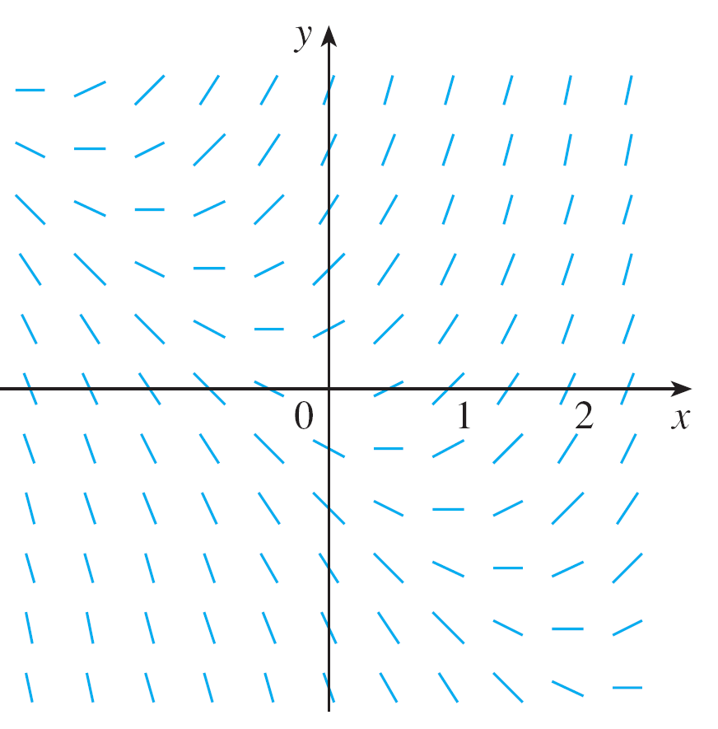
Direction Fields
As a guide to sketching the rest of the curve, let’s draw short line segments at a number of points (x, y) with slope x + y. The result is called a direction field and is shown in Figure 3.

Slide 12
Direction Fields
Section 9.2

Slide 13
Solution

Slide 14
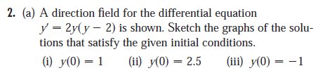
Board Work
Section 9.2

Slide 15
Solutions

Slide 16
Backups

Slide 17
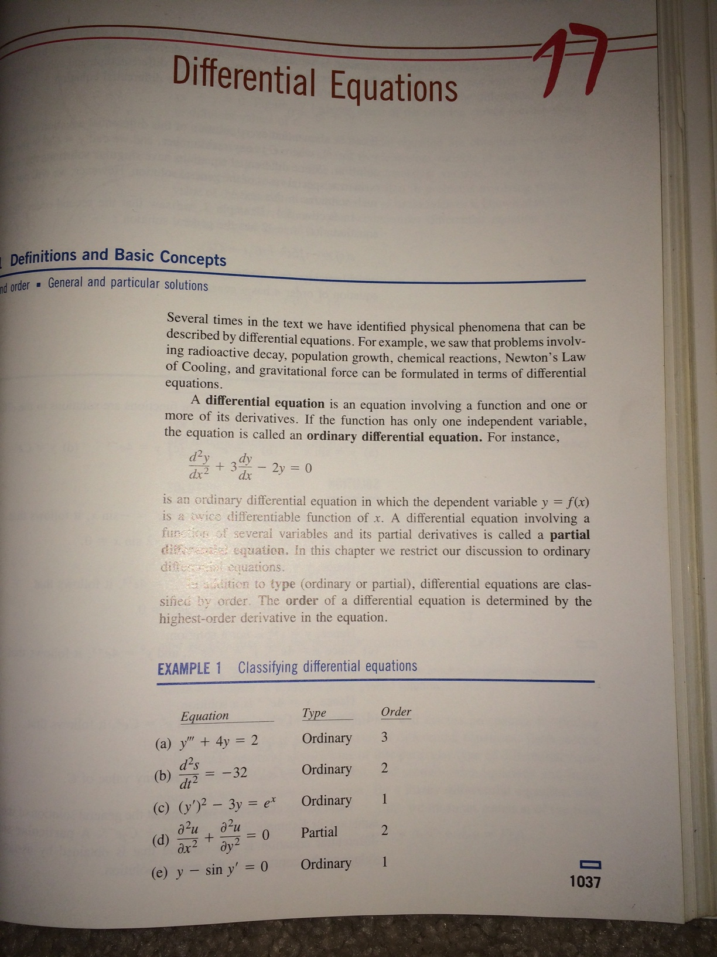

Slide 18
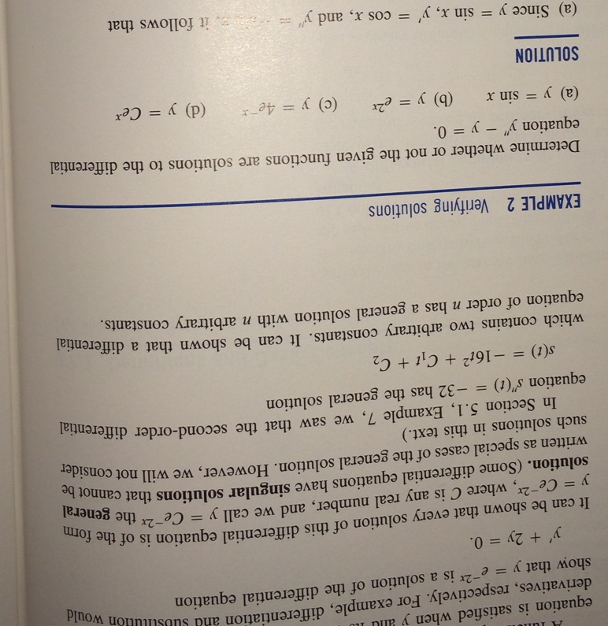

Slide 19

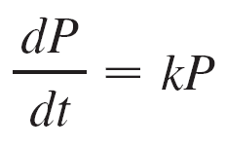
Population Growth
Rate equation (I think velocity)
t = time (the independent variable)
P = number of individuals in the population (the dependent variable)
If we rule out a population of 0, then P (t) > 0 for all t. So, if k > 0, then Equation 1 shows that P ′(t) > 0 for all t.
Let’s try to think of a solution of Equation 1. This equation asks us to find a function whose derivative is a constant multiple of itself.
We know that exponential functions have that property. In fact, if we let P(t) = Ce^{kt}, then
P′(t) = kP(t) = k(Ce^{kt})
Thus any exponential function of the form P(t) = Ce^{kt} is a solution of Equation 1.
Allowing C to vary through all the real numbers, we get the family of solutions P(t) = Ce^{kt} whose graphs are shown above. This is the same idea as discussed previously.

